Slide 1
pecha kucha – Festival of Learning 2016
Fostering Professional Student Identity
Susan Blackley, Rachel Sheffield, Dawn Bennett, Nicoleta Maynard, Rekha Koul, Rebecca Walker and Education & Engineering students.

Slide 2
Makerspace in STEM (MIS) Project
TEDF Grant: This collaborative TEDF project is trialing a dynamic and integrated approach to STEM education through the creation of a virtual and physical STEM Makerspace. The project is a cross-faculty collaboration between the School of Education, Curtin Engineering, and Curtin Teaching and Learning.

Slide 3
Reflective Identity Formation Model (Sheffield & Blackley, 2016).
Phase 1: Workshop with PSTs & ESs
Individual reflective survey
Phase 2:
Mentoring elementary school children
Focus group reflective interviews
Learning by doing: Personal Identity Development
Professional reflection
Personal reflection
Learning by doing: Professional Identity Development

Slide 4
Outline of the MIS project
Opening of the physical Makerspace
Training workshop 1
School visit 1
Training workshop 2
School visit 2
Training workshop 3
School visit 3

Slide 5
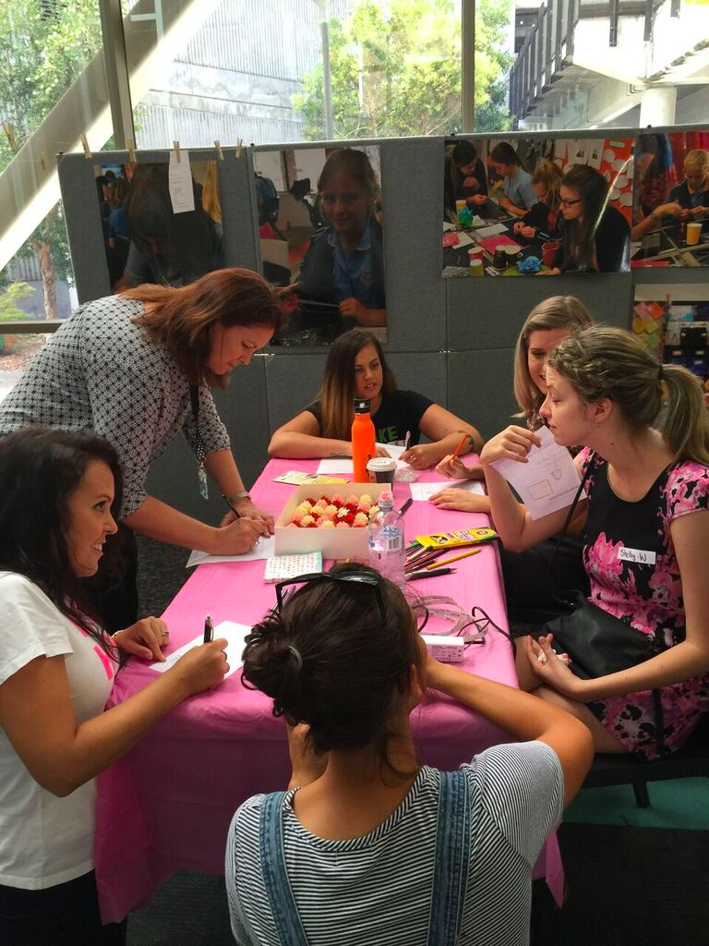
Opening of the Makerspace

Slide 6
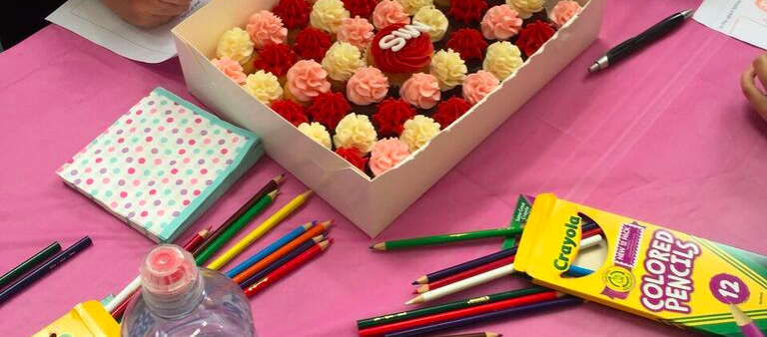
Opening of the Makerspace

Slide 7
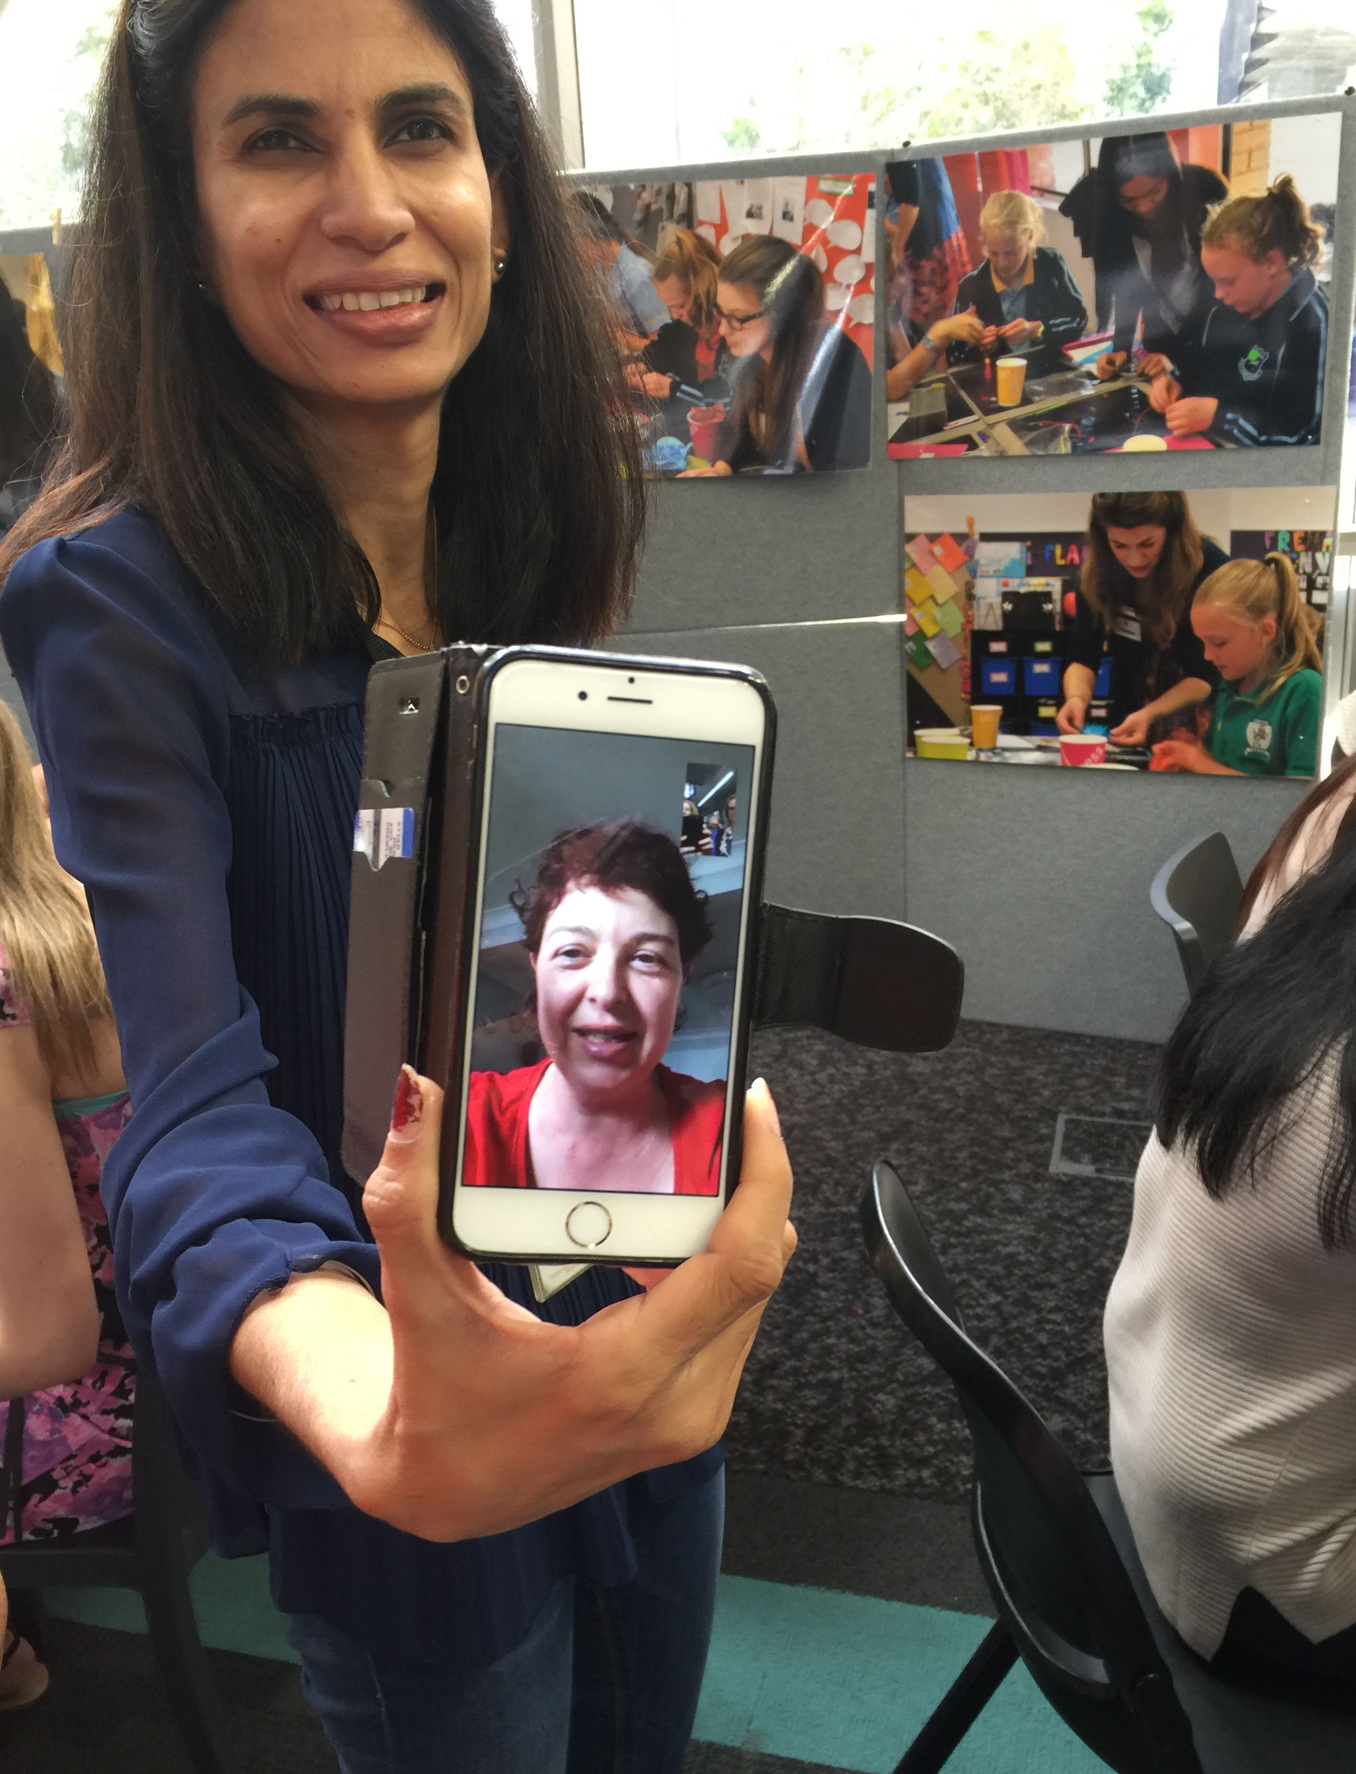
Opening of the Makerspace

Slide 8
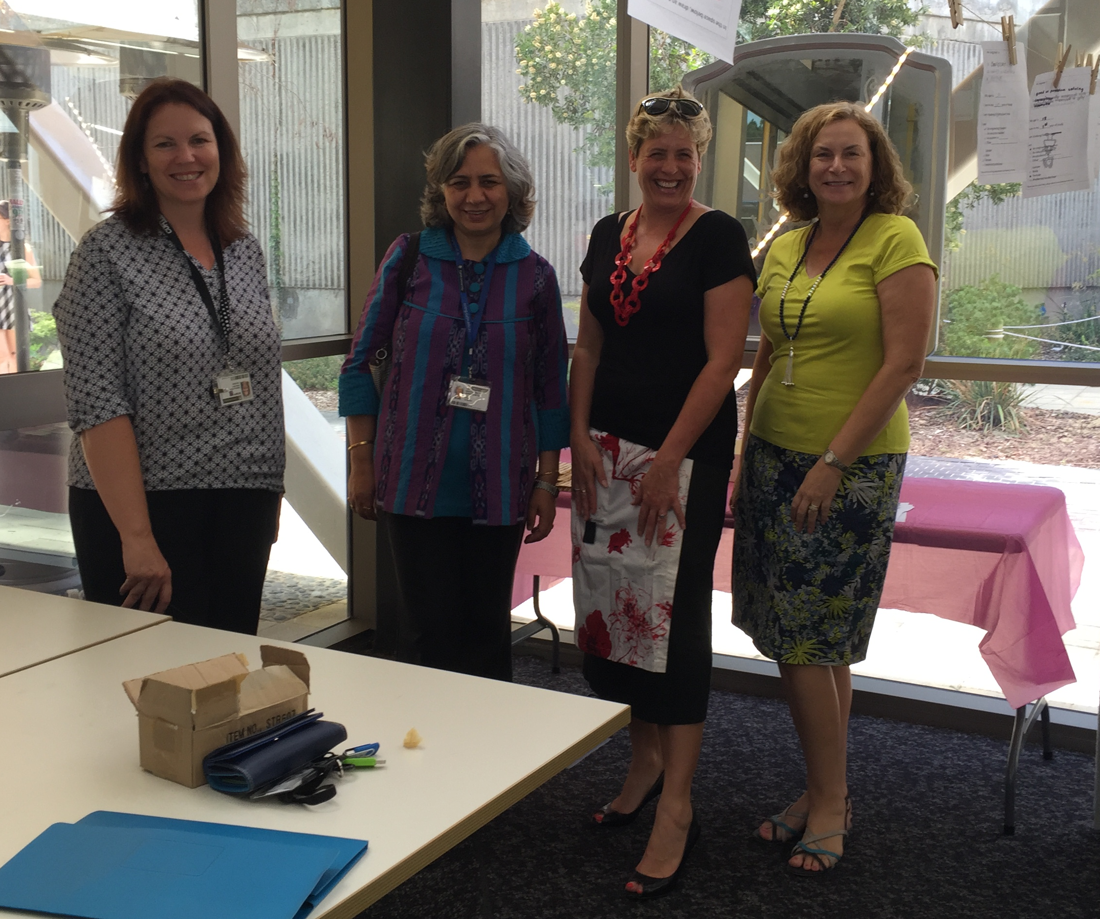
Opening of the Makerspace

Slide 9
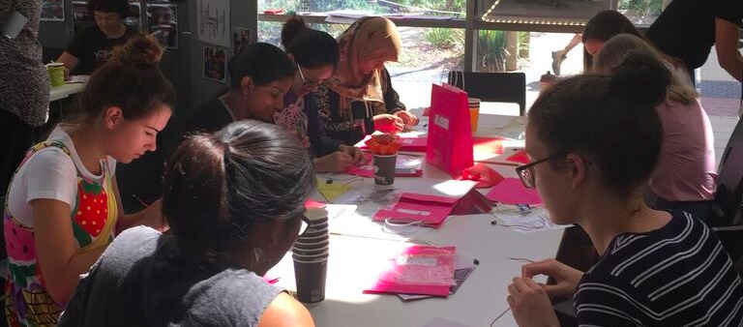
Training workshop 1

Slide 10
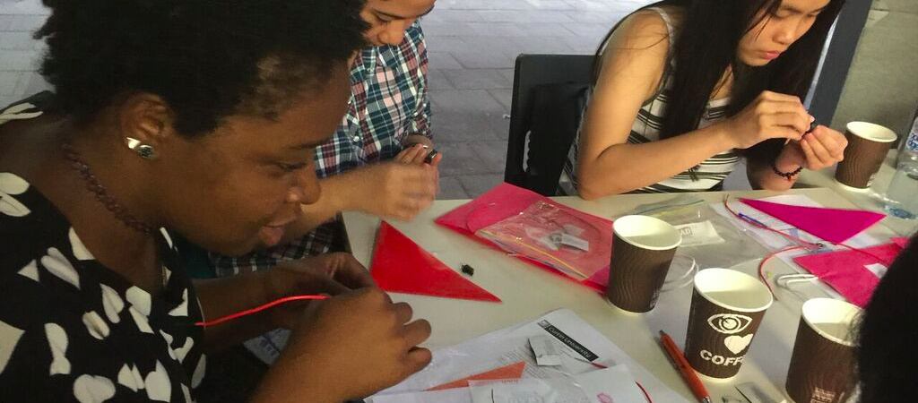
Training workshop 1

Slide 11
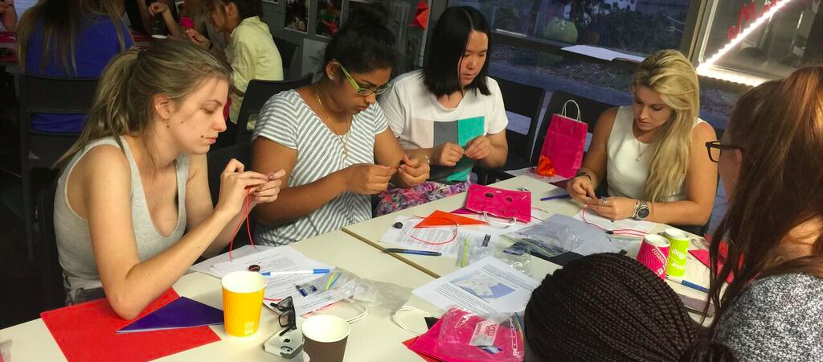
Training workshop 1

Slide 12
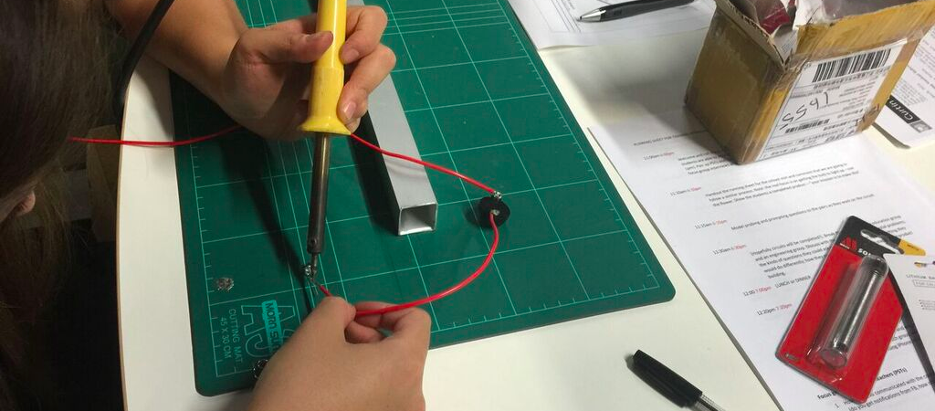
Training workshop 1

Slide 13
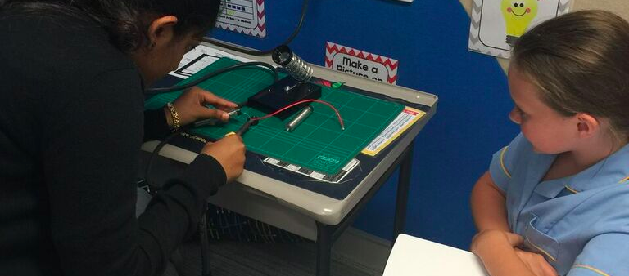
School visit 1

Slide 14
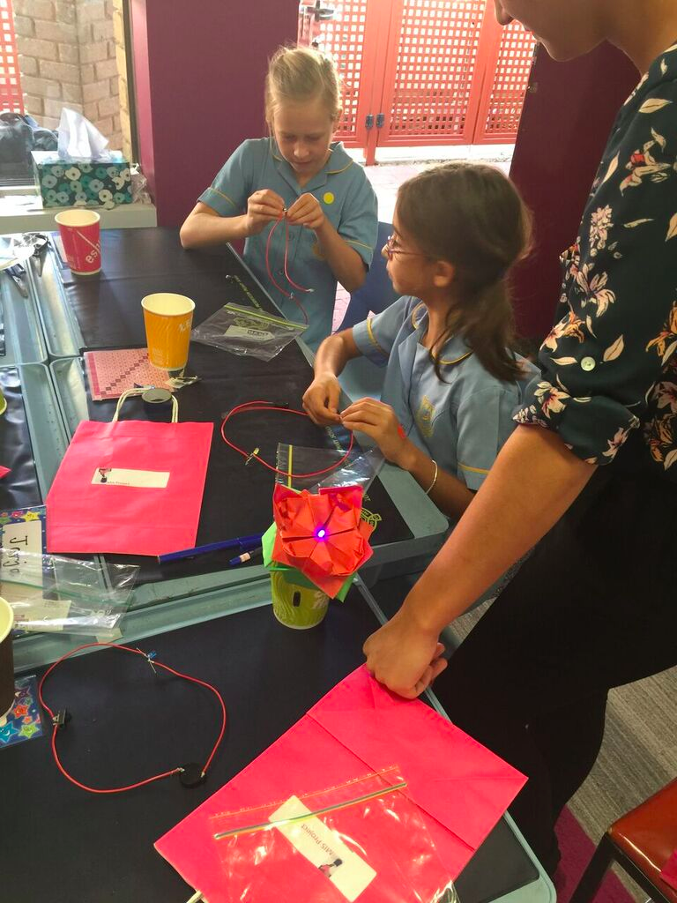
School visit 1

Slide 15
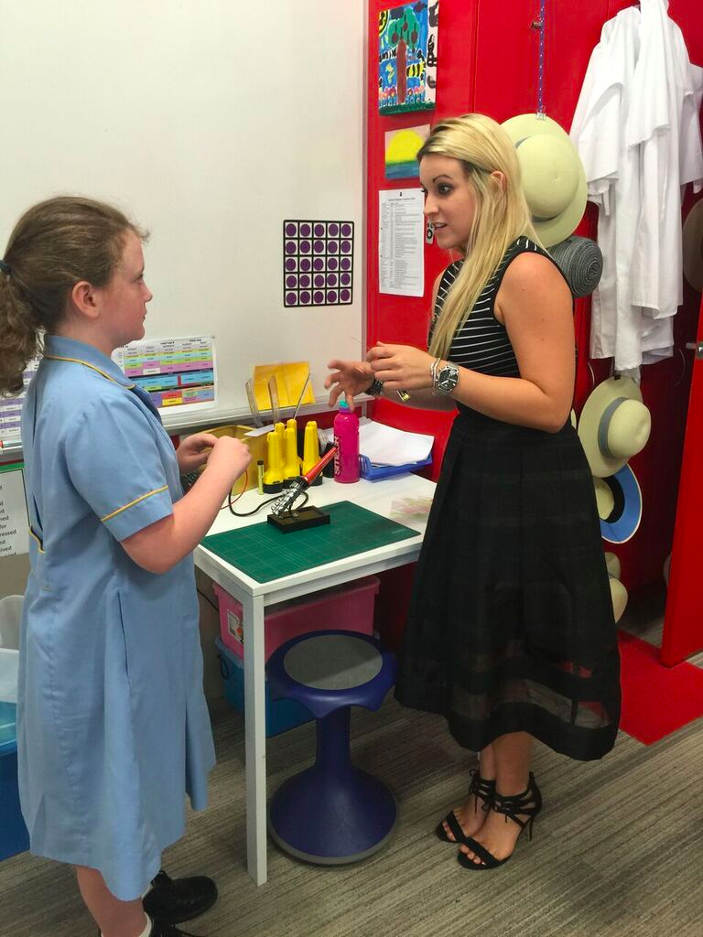
School visit 1

